Slide 1
Designing, programming, and verifying (large scale) distributed systems
MVDE@SEI Summer School INRIA – ECNU Shanghai July 7-10 2014
Eric Madelaine
eric.madelaine@inria.fr
INRIA Sophia-Antipolis
SCALE team

Slide 2
Context & people
Scale research team at INRIA Sophia-Antipolis
http://www-sop.inria.fr/scale
3 years of collaboration with SEI@ECNU:
Research (distributed systems, semantics, formal methods)
Common PhD
Master internships
Internship (master) available this autumn (Oct. – Dec.).
Urgent, please contact me this week !
eric.madelaine@inria.fr
Also:
Master (1&2) track “Ubiquitous Systems & Networks”
at University of Nice Sophia-Antipolis.

Slide 3
Goals of the Course
Explore some features of component-based software
Fractal and GCM component models
GCM architecture and execution principles
VerCors: A software platform for abstract specification and verification of GCM applications
Understand a non-trivial case-study in (model-checking) behavior verification
Hands-on session
Specification of distributed component architecture and behaviour with the VCE tools.

Slide 4
AGENDA
Vocabulary and context
specification, modeling, testing, verification…: Formal methods in the design flow of distributed/embedded systems
Modeling Software Component Systems :
Fractal / GCM Component Framework
The VerCors platform:
architecture (ADL) and behavior specification formalisms Model-checking GCM applications
The BFT case-study

Slide 5
Formal methods
Formal methods :
Provide mathematical semantics to models so that their relation to implemented product can be asserted and proved :
specification formalisms, (temporal) logics
model checking, equivalence checking, theorem-proving
certification, testing
model-based test generation
Modeling languages:
UML and variants (State machines, StateCharts, SysML,…)
Dedicated IDLs and ADLs for system decomposition (…)
Assertion languages (annotations)
In blue, keywords of this course

Slide 6
Design Cycle
Requirements capture
Sign-off
Global testing
(Initial) specification
Architectural division
Integration
IP component reuse
Component design / programming
Component testing
libraries
Implementation

Slide 7
Design cycle
This Course
Correctness w.r.t. requirements
Requirements capture
Sign-off
Early specification of Architecture and Interaction
Global testing
(Initial) specification
Correct composition: interface compatibility, deadlock freeness, spec implementation
Architectural division
Integration
Test generation
IP component reuse
Synthesis
Component testing
libraries
Black box specification
Correct-by-Construction Implementation

Slide 8
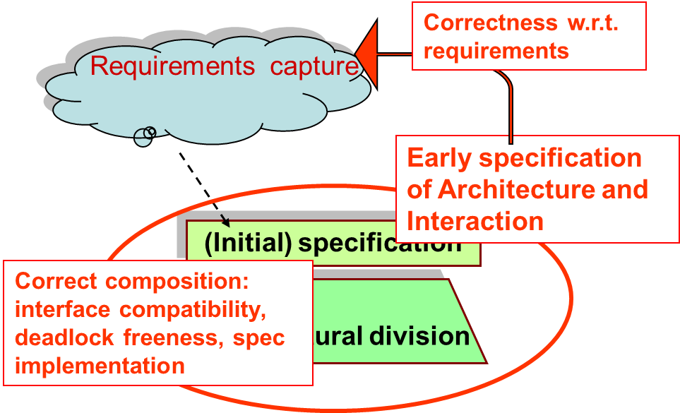
Modeling & Verifying Component Systems
Goal:
Early specification of an Abstract view of the system:
Architecture, Behavior, Requirements.
Model-checking based verification:
Correct composition, Deadlock analysis, Correctness w.r.t. Requirements
Through finite model generation.
Implementation:
Preferably “Correct by construction” code, partially generated from models.
Next sections of this course
with focus on Fractal/GCM

Slide 9
AGENDA
Vocabulary and context
specification, modeling, testing, verification…: Formal methods in the design flow of distributed/embedded systems
Modeling Software Component Systems :
Fractal / GCM Component Framework
The VerCors platform:
architecture (ADL) and behavior specification formalisms
Model-checking GCM applications
The BFT case-study

Slide 10
At the beginning there was… The Fractal project
Reflective software component model technology for the construction of highly adaptable, and reconfigurable distributed systems
A programming-language independent component model
A set of tools to support programming and assembling
Software industries needs (≠ object-orientation):
Dependencies, assembly, packaging, deployment, configuration
Open and adaptable/extensible
Component [Szyperski, 2002]:
“A component is a unit of composition with contractually specified interfaces and context dependencies only. A software component can be deployed independently and is subject to composition by third parties.”

Slide 11
The Fractal component model
Systems and middleware engineering
Generic enough to be applied to any other domain
Fine grain (opposed to EJB or CCM), close to a class model
Lightweight (low overhead on top of objects)
Independent from programming languages
Homogeneous vision of all layers (OS, middleware, services, applications)
Usable as a component framework to build applications
with “standard” Fractal components
Usable as a component framework framework
building different kinds of components
with minimum introspection and simple aggregation (à la COM)
with binding and lifecycle controllers (à la OSGi)
with a two-level hierarchy and bindings (à la SCA)
with persistence and transaction controllers (à la EJB)
with attribute controllers (à la MBean)
Notes:
Keep as an advertisement, but do not comment during course.

Slide 12
What are (GCM/Fractal) Components?
Bindings
NF (server) interfaces
Server interfaces
Composite component
Client interfaces
Primitive component
Business code
Primitive component
Business code
Hierarchical
Extensible
Reflexive: runtime component management
Separate functional / non-functional concerns

Slide 13
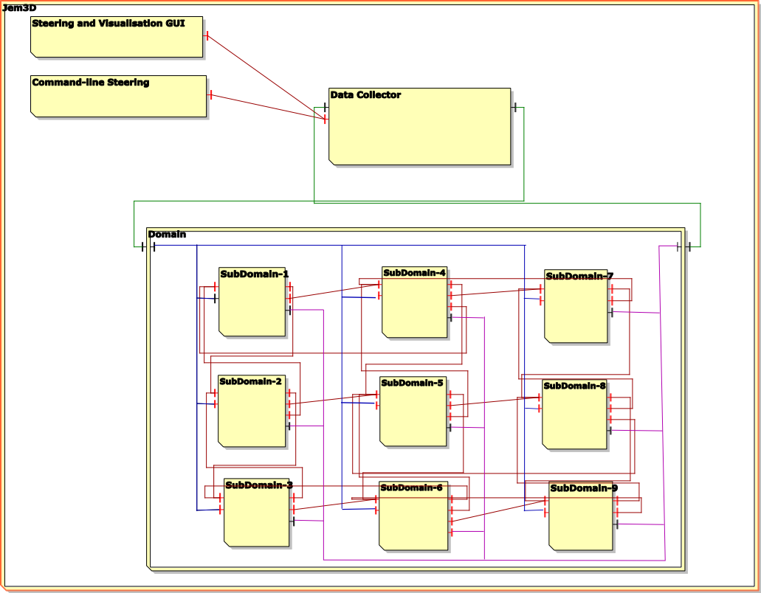
GCM Grid Component Model
A Fractal Extension :
Scopes and Objectives:
Grid/Cloud Codes that Compose and Deploy (on distributed infrastructures)
No programming, No Scripting, …
Innovations:
Abstract Deployment
Multicast and GatherCast
Controller (NF) Components
Standardization
By the ETSI TC-GRID (2008-2010)

Slide 14
GCM: asynchronous model
Distributed components :
No shared memory
Communication = Remote Method Call
Physical infrastructure ≠ logical (virtual) architecture
Large scale Grid/Cloud computations:
Multicast and gathercast interfaces
Asynchrony of computation :
Remote Calls are non-blocking
Notion of Future Objects.

Slide 15
A Primitive GCM Component
CI.foo(p)
Primitive components communicating by asynchronous remote method invocations on interfaces (requests)
Components abstract away distribution and concurrency
in GCM/ProActive components are mono-threaded ➔ simplifies concurrency but can create deadlocks

Slide 16
Futures for Components
f=CI.foo(p) ……….
f.bar()
f.bar()
Component are independent entities
(threads are isolated in a component)
+
Asynchronous method invocations with results
⬇
Futures are necessary

Slide 17
Replies
…
…
…
f=CI.foo(p)
f.bar()

Slide 18
What is a Future?
Future = Placeholder for an awaited result
Creation of a future
How and when are futures created?
Implicit creation = automatic upon asynchronous invocation (on a remote object)
Explicit creation = there is a future construct
Manipulation and access
How to manipulate the futures?
Explicit access = get operation (+ future type)
Implicit (transparent) access = any variable can contain a future

Slide 19
First-class Futures
…
…
…
f=CI.foo(p)
CI.foo(f)
CI.foo(f)
Only strict operations are blocking (access to a future)
Communicating a future is not a strict operation

Slide 20
First-class Futures and Hierarchy
f=f’
Without first-class futures, one thread is systematically blocked in the composite component.

Slide 21
First-class Futures and Hierarchy
… … …
Almost systematic dead-lock in GCM/ProActive
A lot of blocked threads otherwise

Slide 22
Reply Strategies
In ASP / ProActive, the result is insensitive to the order of replies (shown for ASP-calculus)
experiments with different strategies (lazy, eager)

Slide 23
Summary
Primitive components contain the business code
Primitive components act as the unit of distribution and concurrency (each thread is isolated in a component)
Communication is performed on interfaces and follows component bindings
Futures allow communication to be asynchronous requests
Futures are transparent can lead to optimisations and are a convenient programming abstraction but …

Slide 24
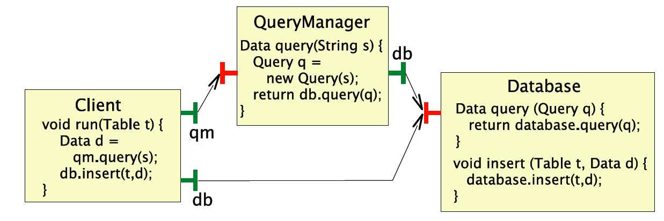
What Can Create Deadlocks?
A race condition:
Detecting deadlocks can be difficult ➔ behavioural specification and verification techniques
What should be done to avoid such a deadlock?
(add synchronisation)

Slide 25
Fractal/GCM : controllers
Control
Non functional (technical) properties
Implemented in the membrane
Made of a set of controllers
E.g. security, transaction, persistence, start/stop, naming, autonomicity
Controllers accessible through a control interface
Controllers and membranes are open
Predefined :
Life-cycle
Binding controller
Attribute controller
Content controller

Slide 26
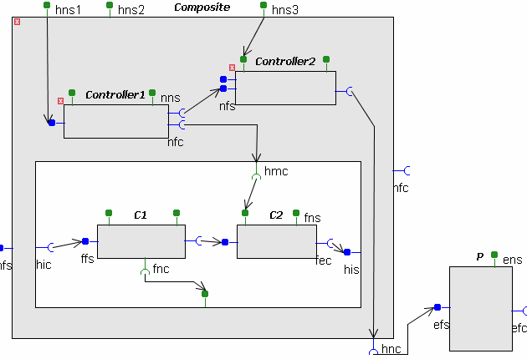
GCM: components for controllers
“Componentize” the membrane:
Build controllers in a structured way
Reuse of controller components
Applications: control components for self-optimization, self-healing, self-configuring, interceptors for encryption, authentication, …
Membrane and controllers:
A way to improve Separation of concerns

Slide 27
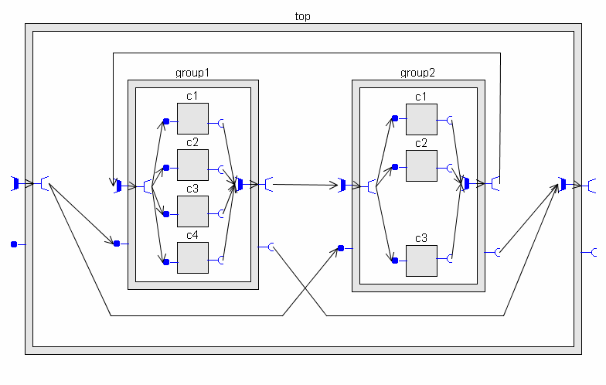
GCM: NxM communication
1 to N = multicast / broadcast / scatter
N to 1 bindings = gathercast
Attach a behaviour (policy) to these interfaces
Group architecture and communication policies:
Allows for (high performance)
very large scale applications,
With easy and portable architecture specification

Slide 28
AGENDA
Vocabulary and context
specification, modeling, testing, verification…: Formal methods in the design flow of distributed/embedded systems
Modeling Software Component Systems :
Fractal / GCM Component Framework
The VerCors platform:
architecture (ADL) and behavior specification formalisms
Model-checking GCM applications
The BFT case-study

Slide 29
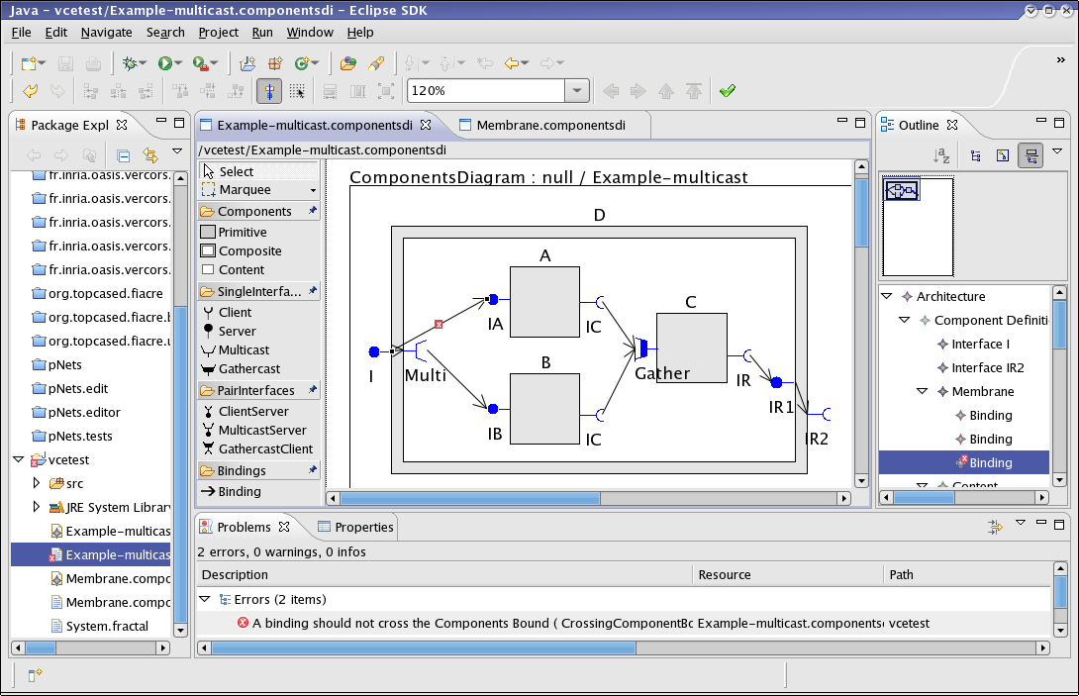
GCN high level specifications: The VCE tool

Slide 30
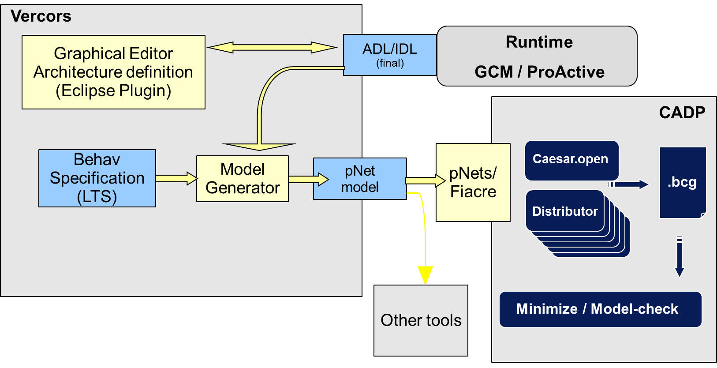
Model-checking applications: The Vercors platform
(partial)
Code generation
Specification:
Graphical
editors
Generation
Of the
Semantic model
Model Checking

Slide 31
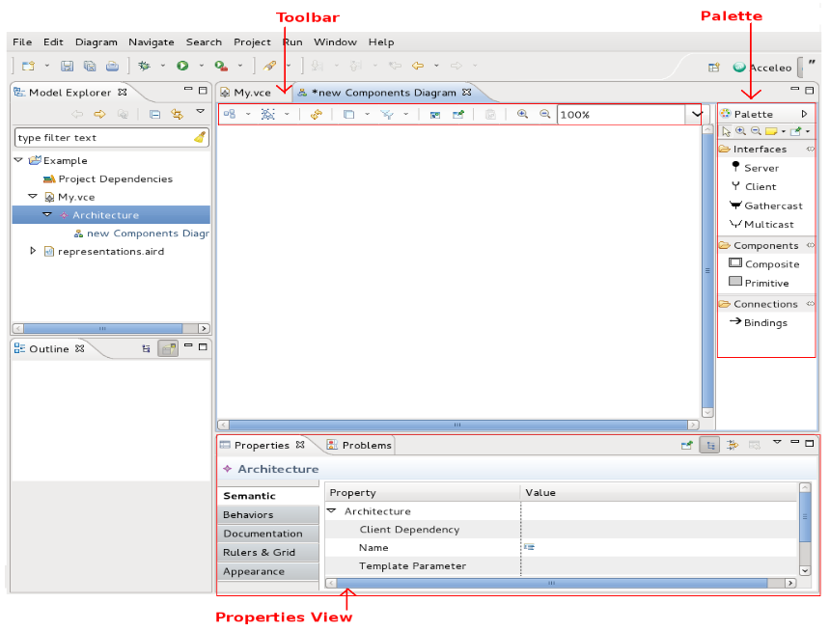
An Eclipse / Obeo environment

Slide 32
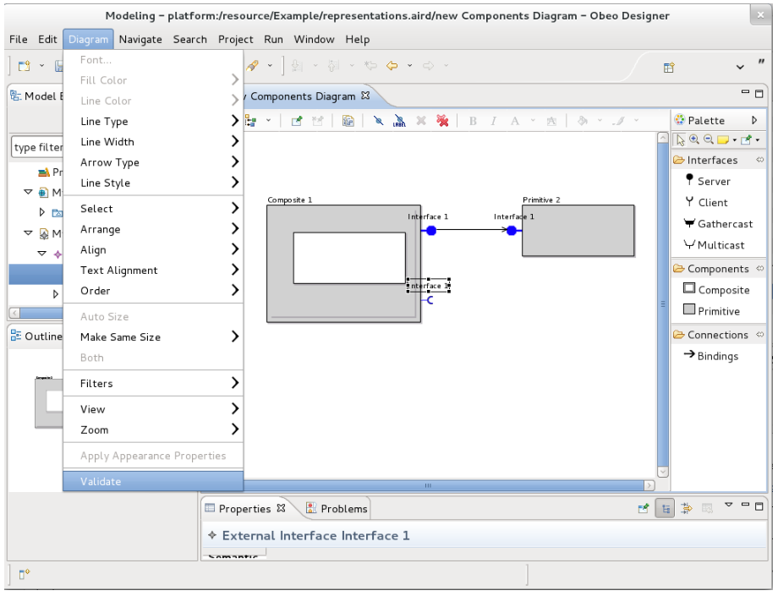
The graphical formalisms: (1) Architecture
GCM full ADL, with full componentized membrane, and multicast/gathercast

Slide 33
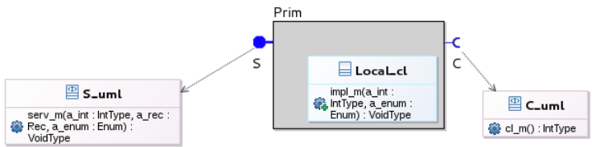
The graphical formalisms: (2) Interfaces
UML class diagram, for interface signatures, and primitive component implementation class

Slide 34
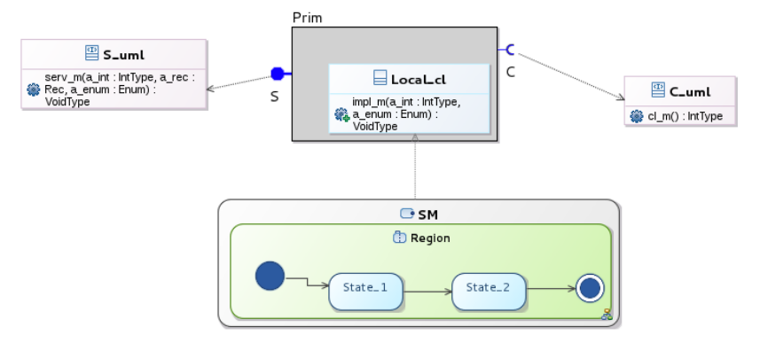
The graphical formalisms: (3) behaviors
UML state machines, with a specific label language

Slide 35
Validity check, code & model generation
Semantic validity rules:
Structural (components, bindings, interface roles)
Typing (interface compatibility)
Behavioral (variables/methods well-definedness)
Guarantees generation of correct code:
ADL file (for GCM/ProActive component factory)
Behavior model (for model-checking)

Slide 36
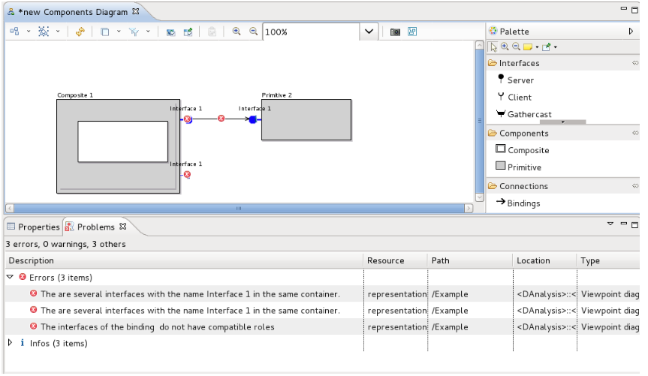
Validity check, code & model generation

Slide 37
AGENDA
Vocabulary and context
specification, modeling, testing, verification…: Formal methods in the design flow of distributed/embedded systems
Modeling Software Component Systems :
Fractal / GCM Component Framework
The VerCors platform:
architecture (ADL) and behavior specification formalisms
Model-checking GCM applications
The BFT case-study

Slide 38
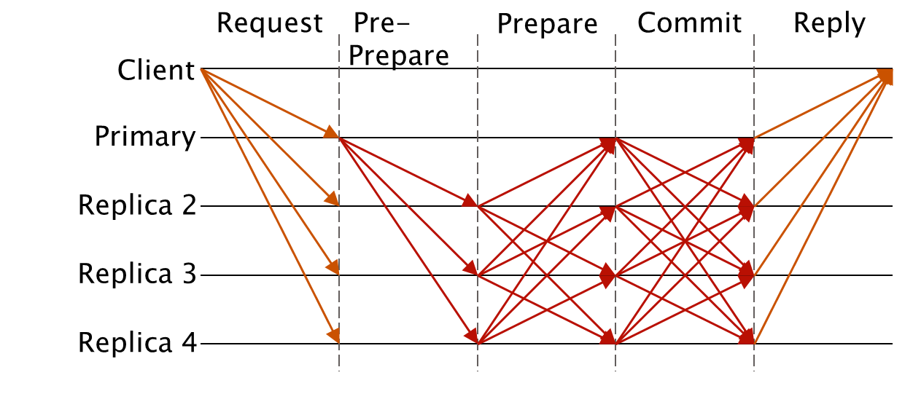
Byzantine Fault Tolerant Systems
Byzantine systems:
“bad” guys can have any possible behaviour,
everybody can turn bad, but only up to a fixed % of the processes.
Very large Bibliography:
Algorithms
Correctness proofs

Slide 39
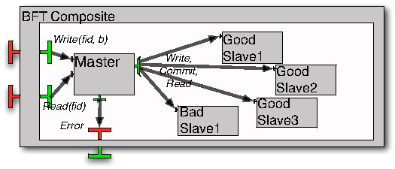
Modelling a BFT application in GCM
VCE diagram
1 composite component with 2 external services Read/Write.
The service requests are delegated to the Master.
Fig 3 from paper
Note: 3f+1 slaves
1 multicast interface sending write/read/commit requests to all slaves.
the salves reply asynchronously, the master only needs 2f+1 coherent answers to terminate

Slide 40
Our simplification hypothesis
The master is reliable: this simplifies the 3-phases commit protocol, and avoid the consensus research phase.
The underlying middleware ensures safe communications: faulty components only respond to their own requests, and communication order is preserved.
To tolerate f faults we use 3f+1 slaves, and require 2f+1 agreeing answers, as in the usual BFT algorithms.

Slide 41
Requirements (= logical properties)
1- Reachability(*):
- The Read service can terminate
∀ fid:nat among {0...2}. ∃ b:bool. <true* . {!R_Read !fid !b}> true
- Is the BFT hypothesis respected by the model ?
< true* . 'Error (NotBFT)'> true
2- Termination:
After receiving a Q_Write(f,x) request, it is (fairly) inevitable that the Write services terminates with a R_Write(f) answer, or an Error is raised.
3- Functional correctness:
After receiving a ?Q_Write(f1,x), and before the next ?Q_Write, a ?Q_Read requests raises a !R_Read(y) response, with y=x
(*) Model Checking Language (MCL), Mateescu et al, FM’08
Notes:
How the case study was split into a workflow
that can be run as a ProActive Scheduler job on PacaGrid
41

Slide 42
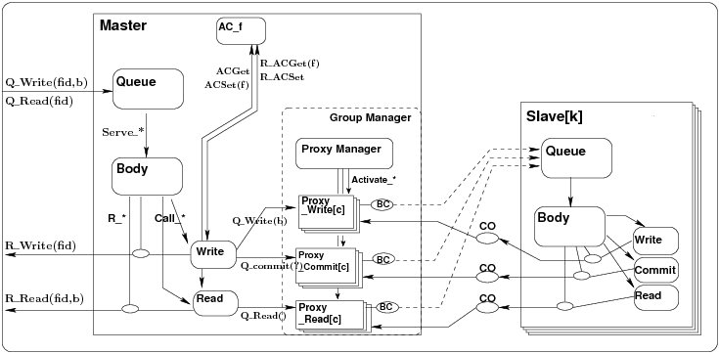
Semantic Model: network of processes (hierarchical, parameterized)
Process hierarchy
to be generated by VerCors
R. Ameur-Boulifa, L. Henrio, E. Madelaine, A. Savu,
« Behavioral Semantics for Distributed Components »,
Research report RR-8167, INRIA, dec. 2012.

Slide 43
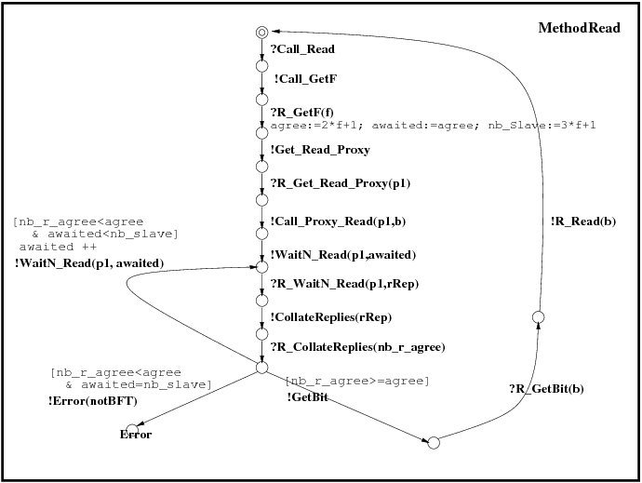
Basic Processes : parameterized LTSs
Labelled transition systems, with:
Value passing
Local variables
Guards….
ATG drawing
(but could be UML state-machines
as well)
Eric MADELAINE
43

Slide 44
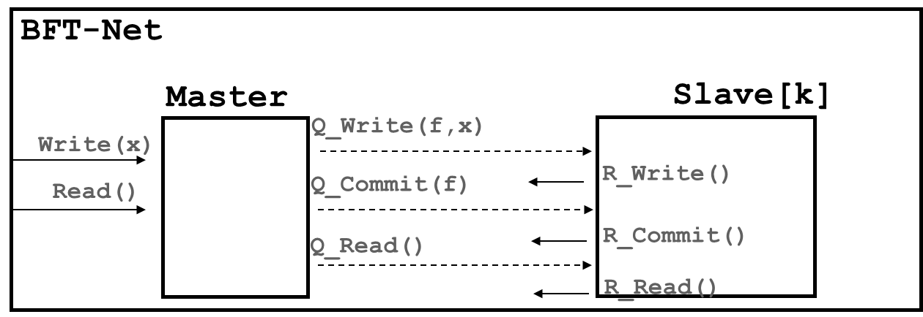
Combining processes: generalized parallel operator
BFT-Net : < Master, Slave_1,…,Slave_n > k ∈ [1:n]
with synchronisation vectors :
<?Write(x), - , …, - > => ?Write(x)
<!Q_Write(f,x), ?Q_Write(f,x) , …, ?Q_Write(f,x) > => Q_Write(f,x)
∀k <?R_Write(f,k), - , …, !R_Write(f), …, - > => R_Write(f,k)
EXP format
(to be generated by VerCors)
Notes:
Utiliser Master – Slave[k] ??

Slide 45
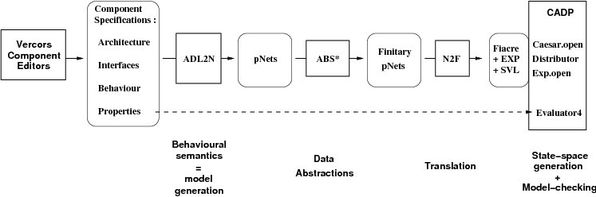
VerCors: Platform Architecture
Goal:
fully automatic chain
Current state of the platform:
production of the CADP input formats only partially (~50%) available.

Slide 46
Generation of state-space
Taming state-space explosion:
Data abstraction (through abstract interpretation):
integers => small intervals
arrays … => reduce by symmetry arguments.
Partitioning and minimizing by bisimulation + context specification
Distributed verification engines,
Only partially available (state-space generation, but no M.C.).
3 Tbytes of RAM ?
Notes:
Size problems usually occur essentially during debugging phases…

Slide 47
State-space generation workflow
MQueue.fcr
MBody.fcr
WriteProxy.fcr
Flac +
Distributor
+ Minimize
…
Master Queue
Master Body
Write Proxy
MQueue.bcg
MQueue.bcg
WriteProxy.bcg
Build product
Master.exp
(Hide/Rename)
Minimize
Master.exp
…
Notes:
How the case study was split into a workflow
that can be run as a ProActive Scheduler job on PacaGrid
47

Slide 48
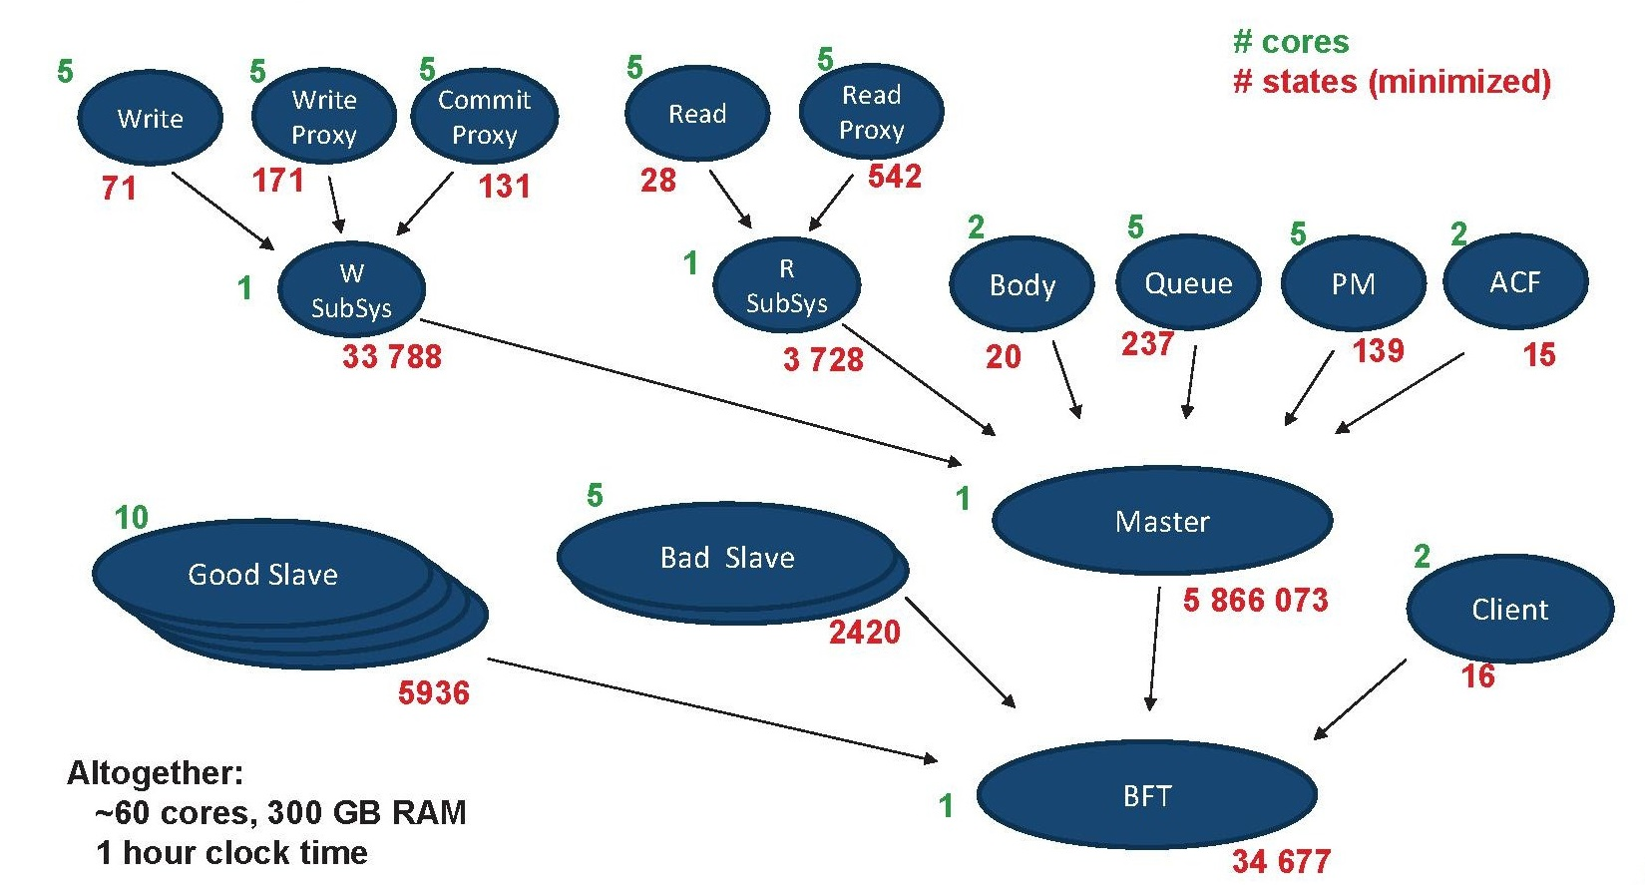
State-space generation workflow
Notes:
How the case study was split into a workflow
that can be run as a ProActive Scheduler job on PacaGrid
48

Slide 49
Distributed State generation
Abstract model: (for a fixed valuation of the parameters):
f=1, (=> 4 slaves), |data|= 2, |proxies|=3*3, |client requests|=3
Master queue size = 2
~100 cores, max 300 GB RAM
System parts sizes (states/transitions):
Queue | Largest intermediate | Master | Good Slave | Global |  | Time
237/3189 | 524/3107 | 5M/103M | 5936/61K | 34K/164K |  | 59’
Estimated brute force state spaces :
10¹⁸ | 6.10³ | ~ 10³²

Slide 50
Some Research Challenges
Tooling :
hide model-checker internal languages,
show results in user-level formalism.
Scale-up:
better abstraction techniques for useful datatypes (e.g. arrays),
better distributed Model-Checking engines,
compositional techniques,
minimization of the size of the semantic model
Verifying dynamic distributed systems (GCM + Reconfiguration):
handle Life-cycle and Binding Controllers,
encode sub-component updates,
several orders of magnitude bigger.
=> In the long term, combine model-checking & theorem-proving
N. Gaspar, L. Henrio, E. Madelaine,
« Formally Reasoning on a Reconfigurable Component-Based System --- A Case Study for the Industrial World »,
FACS’13, Nanchang, China, oct. 2013.

Slide 51
Conclusion
Component frameworks: provide method, tools, middleware for programming large-scale applications
Vercors: an example of a modeling+verification framework for component-based applications
Model-checking distributed component systems: large use-cases – mehtods for mastering state-space explosion
http://www-sop.inria.fr/oasis/Vercors
+ Available master/PhD subjects at INRIA/Scale
+ International Master track at University of Nice Sophia-Antipolis

Slide 52
More References
Fractal & GCM:
http://fractal.objectweb.org/ [doc tutorials]
http://www-sop.inria.fr/members/Eric.Madelaine/Teaching/Ubinet2010/2006-GCM-GridsWork.ppt
F. Baude, D. Caromel, C. Dalmasso, M. Danelutto, V. Getov, L. Henrio, C. Perez: GCM: A Grid Extension to Fractal for Autonomous Distributed Components, in Annals of Telecommunications, Vol. 64, nº1, jan 2009.
pNet [def & semantics]: http://hal.inria.fr/hal-00761073
Overview:
E. Madelaine, Specification, Model Generation, and Verification of Distributed Applications, sept. 2011, URL: http://hal.inria.fr/index.php?halsid=o3253cd31tsjbo0bo40ogqas53&view_this_doc=tel-00625248
Vercors:
http://www-sop.inria.fr/oasis/Vercors/software/VCEv3 (download, examples)
Case-studies:
R. Ameur-Boulifa, R. Halalai, L. Henrio, E. Madelaine, Verifying Safety of Fault-Tolerant Distributed Components - Extended Version, RR INRIA #7717, sept 2011, URL: http://hal.inria.fr/inria-00621264/
Nuno FACS’14

Slide 53
Thank you
谢谢
Merci
Papers, Use-cases, and Tools at :
http://www-sop.inria.fr/oasis/Vercors
Course funded by Associated Team DAESD: INRIA-E.C.N.U.

Slide 54
Hands-on Session
Use-case: Intelligent cars system
Presentation, Basic components & behavior
VCE (VerCors Component Environment):
Installation, Tutorial, Fast start
Example projects
Exercices:
components architecture, interfaces, types
component behavior as GCM State Machines

Slide 55
Installation
VCE-v3 bundles available for win32, win64, linux platforms. Experimental !
Prerequisite: Java7 (jre or jdk) installed
Documents:
Installation instructions
Tutorial
Exercices
Thanks a lot
to Liu Dongqian
and the other volunteer students.

Slide 56
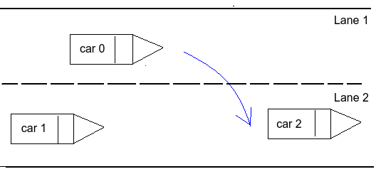
Intelligent cars scenario (from Chen Yanwen PhD research)

Slide 57
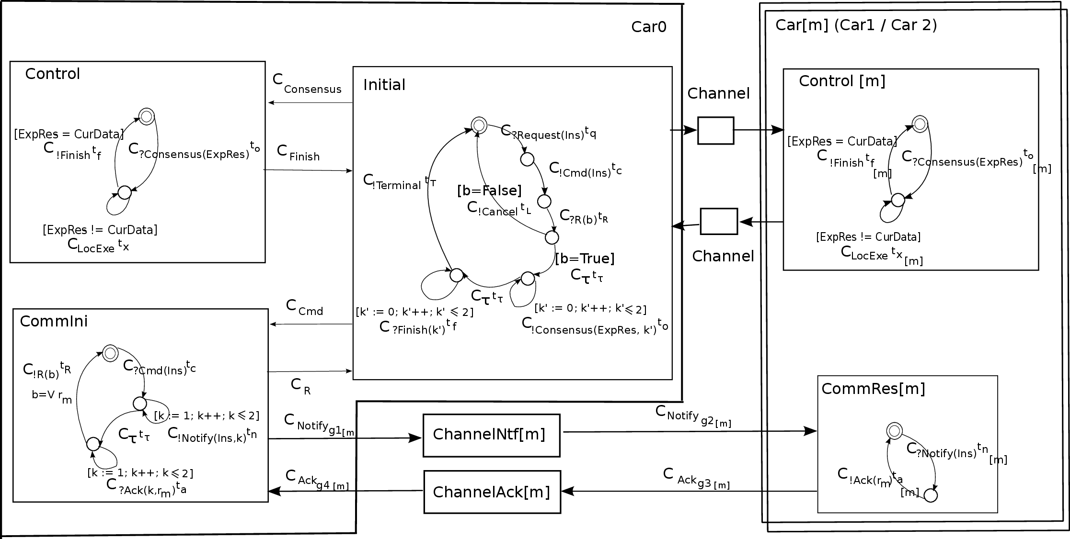
System Architecture

Slide 58
Specific timed model transition language
This use-case was originally built for a timed version of the semantic formalism.
But in the exercises today, only consider the untimed fragment, by dropping the clocks and the time variables.
E.g. in the CommIni component:
C _{?Cmd(Ins)} t _{C} ➔ ?Cmd(Ins)
GCM : RPC style here versus message oriented
(= no return value)

Slide 59
Exercice 1: Architecture
Build a VCE architecture diagram, for the Car0 component, with its 3 subcomponents:
Only the architecture (components, interfaces, bindings) in this first step.
Respect the interface names.
Add a service interface accepting messages from the car driver. Name it “Driver”.
Check the diagram validity.

Slide 60
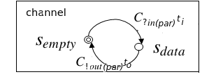
Exercice 2: Channels
Channels here are primitive components with a specific behavior template:
Draw a primitive component with interfaces S1 and C1. Build the UML class diagram of these interfaces, and of the implementation class for the method “In” of the service interface S1.

Slide 61
Exercice 3: Channels behavior
See
Tutorial
Section 2.9
A channel repeatedly receives “In” requests on its service interface. The “In” method receives a parameter, calls the “Out” method on the client interface, then returns.
Attach a state-machine specifying the behavior of the service method “In”.
Use xtext to create the label of the “C.Out” transition of this machine.

Slide 62
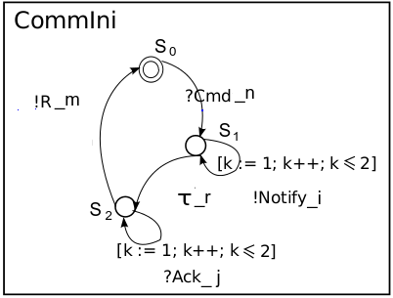
Exercice 4: CommIni component

Slide 63
Exercice 4: CommIni component
This is more complicated…:
CommIni has 2 service interfaces (bound from Initial and from ChannelAck).
When receiving “Cmd(Ins)” from Initial, it sends a number of “Notify” on client Itf ChannelNotify, then wait.
When receiving “Ack(k,r)” from ChannelAck, it stores the corresponding “r_k”. We suppose it receives them in order.
When all received, it computes the result and sends it on Itf “ToInitial”
The way to formalize this in GCM is with 2 service methods, plus a local “body” method describing the (statefull) behavior policy.
Build the class diagram for this impl. Class, then the State machines for the service methods and the body.

Slide 64
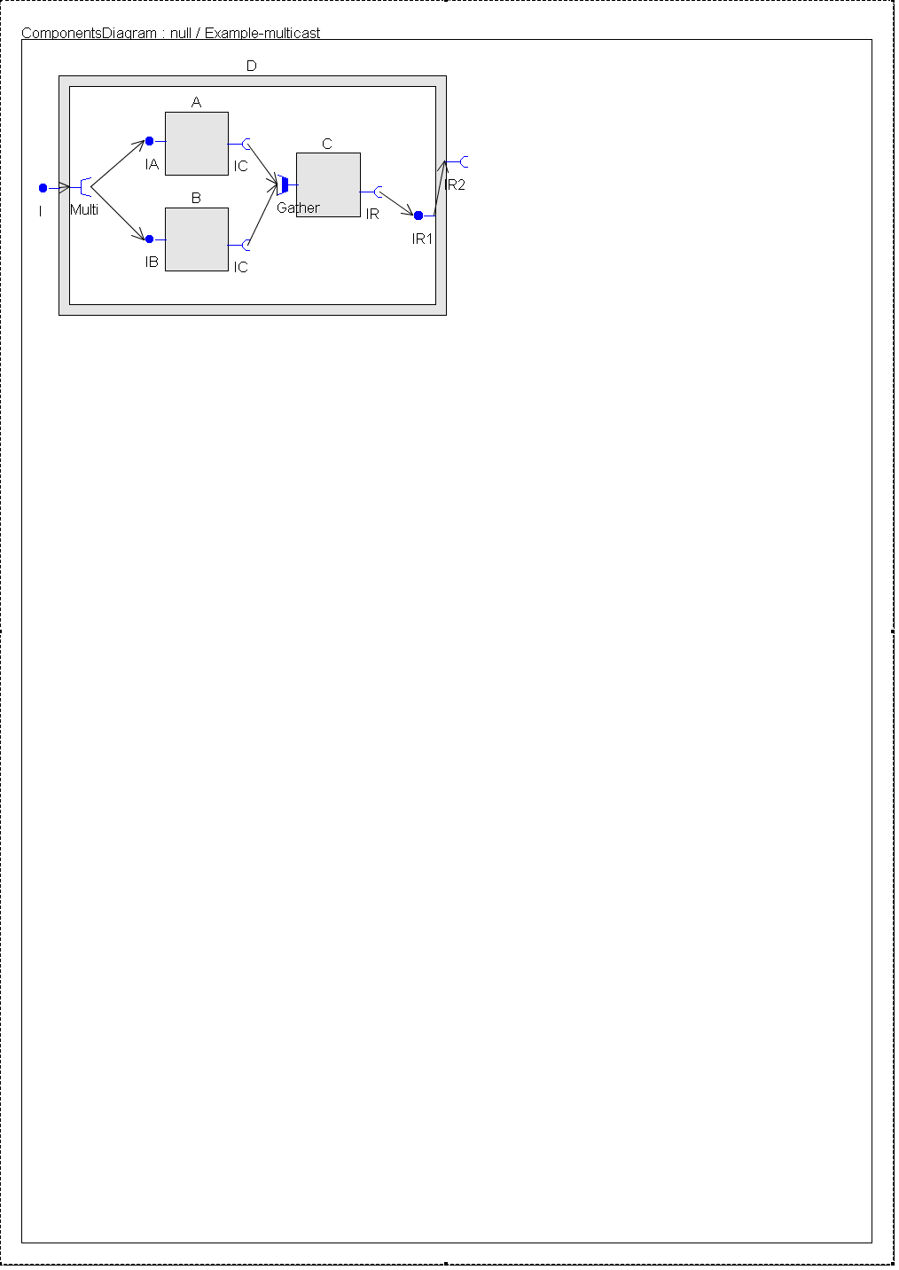
Multicast and gathercast, workflow style

Slide 65
Composite, multicast, matrix (travail à faire en cours)
Build a composite component, with:
One server interface, with an internal multicast interface
2 x 3 subcomponents representing matrix blocks, each linked to its left neighbour

Slide 66
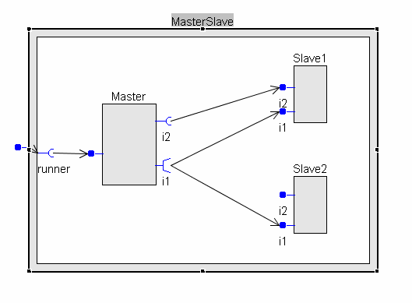
Master/slave, RPC style

Slide 67
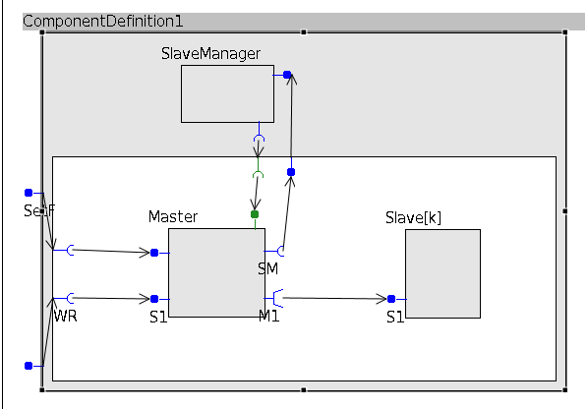
Master/slave, parameterized style

Slide 68
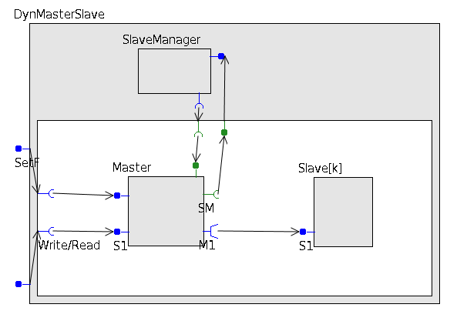
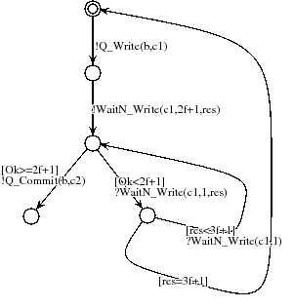
Master/slave, parameterized style

Slide 69
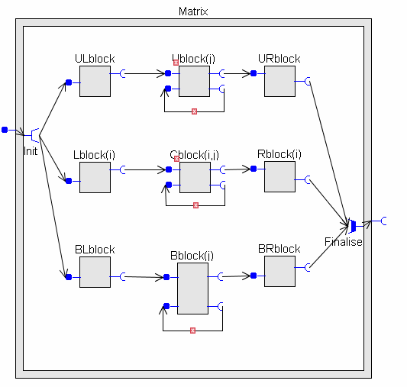
Matrix, parameterized style

Slide 70
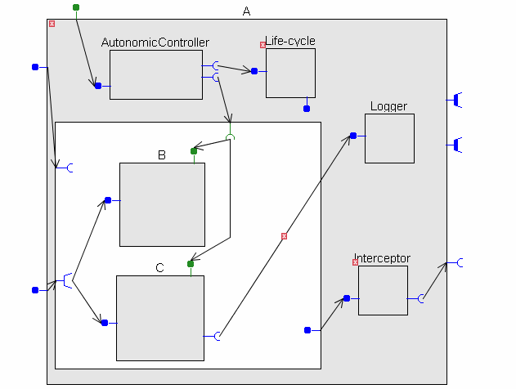
Exercice
Analyze this diagram (semantics, errors, …)

